Slide 1

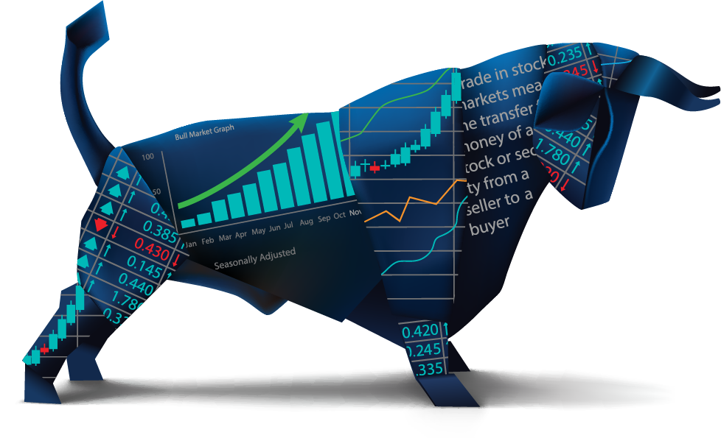
Team 10: Implementing a GRU based network to detect stock prices on FPGA
Sean Kwatra, Xavier Fisher, Kevin Sipple Sponsor: Sambandh Dhal
TA: Eric Robles
ECEN 404
Final Presentation
Notes:
Xavier

Slide 2
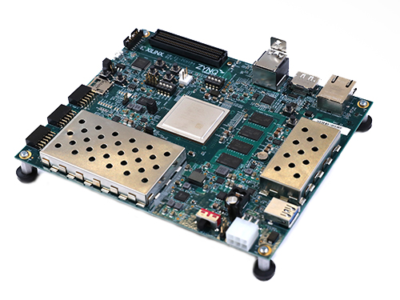
Project Summary
The issue presented to our team:
Retail Traders are inexperienced
Analysis tools are expensive
Paywalls block professional analytics
Our Solution: A GRU Based Stock Prediction System (GBSPS)
Provide a low cost machine learning system capable of running on limited processing power devices.
Provide retail traders with an easy-to-use tool for analyzing stock data and create a accurate prediction of the direction of stock price movement.
Facts
Current estimates place 32% of total U.S. equity volume to be represented by retail traders [ConOps].
The number of active retail traders across six largest non-commission platforms was 100 million [ConOps ( statistic from Jan. 2021)].
Notes:
Kevin

Slide 3
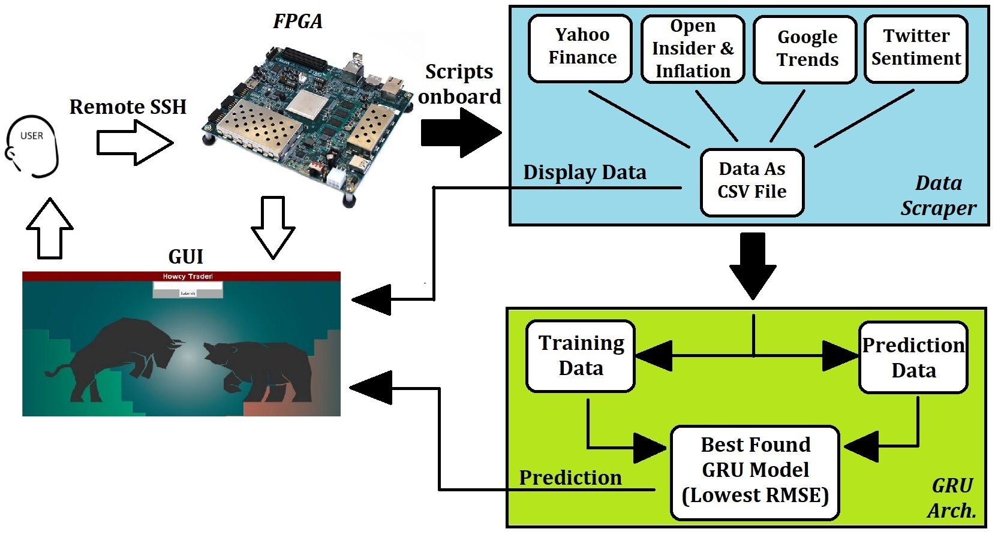
Integrated System Diagram
FPGA - Sean Kwatra
Data Scraper - Xavier Fisher
GRU Arch. - Kevin H. Sipple
Notes:
Kevin

Slide 4
Data Scraping and Processing Subsystem Xavier Fisher
Notes:
Xavier

Slide 5
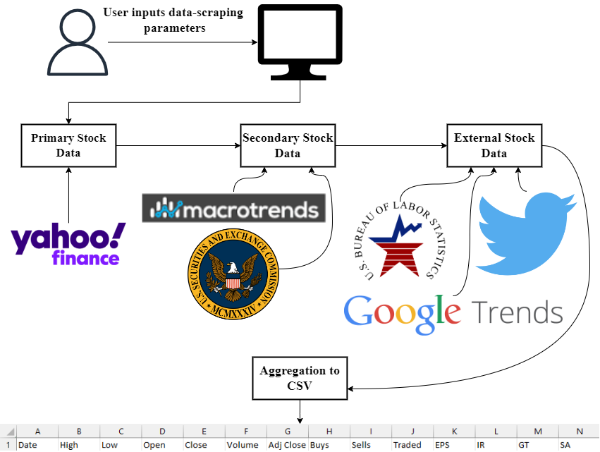
Data Scraping and Processing Subsystem
Xavier Fisher - Overview
Notes:
Xavier

Slide 6
Data Scraping and Processing Subsystem
Xavier Fisher - Specifications
Respective Document | Specification | Status
FSR 1.1 Purpose and Scope | Able to collect and analyze relevant data from the internet. | MET
FSR 3.2.1.3 Accuracy of Collected Data | Collect data only from reputable sources. | MET
Schedule & Validation Plan | Handles empty datasets without interrupting program | MET
Schedule & Validation Plan | Correct data aligned with corresponding date in CSV | MET
Schedule & Validation Plan | No duplicate data appended to CSV | MET
Notes:
Xavier

Slide 7
Data Scraping and Processing Subsystem
Xavier Fisher - Major Challenges and Solutions
Challenges
Collect data automatically from websites
Collect sentiment data
Assigning data correctly/effectively
Google requests timeout
Solutions
Learned and utilized HTML scraping and other web crawling techniques.
Used snscrape and VADER to gather and sentimentally analyze tweets respectively
Changed data assignment to prioritize what information would be available to a trader on that day
Implemented try and catch error handling to ensure robustness of script
Notes:
Xavier

Slide 8
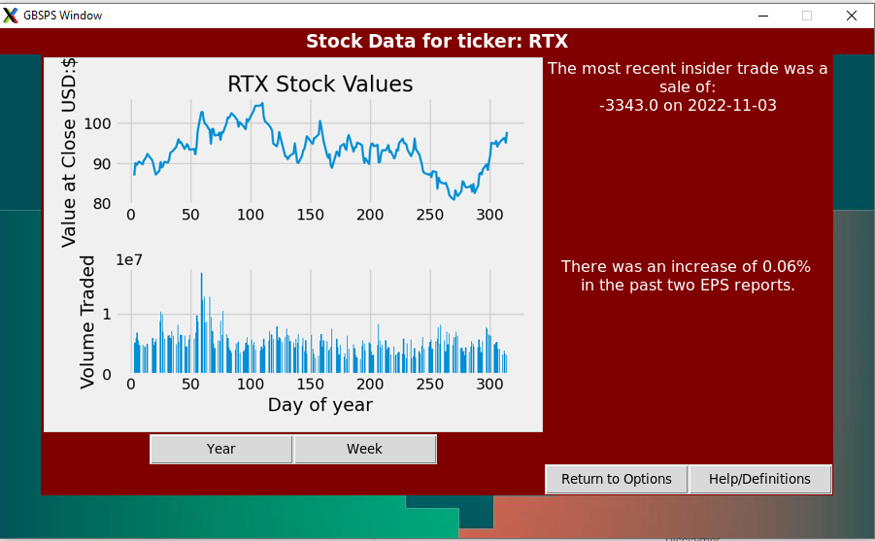
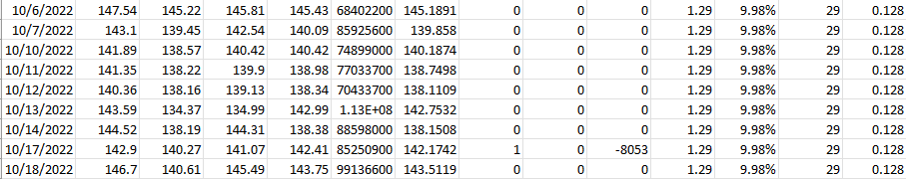
Data Scraping and Processing Subsystem
Xavier Fisher - Results
Visual representation of data generated by GUI
Sample output file from the data scraper (.csv)
Notes:
Xavier

Slide 9
GRU Architecture Subsystem Kevin H. Sipple
Notes:
Xavier

Slide 10
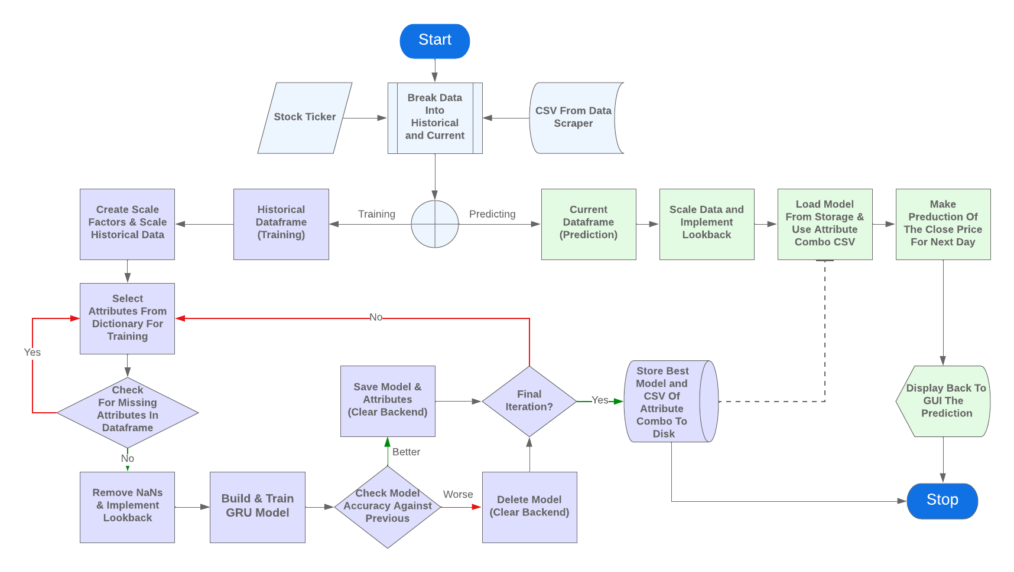
GRU Architecture Subsystem
Kevin H. Sipple - Overview
KEY
Program Begin
Training Path
Prediction Path

Slide 11
GRU Architecture Subsystem
Kevin H. Sipple - Specifications
Respective Document | Specification | Status
Requirement By Sponsor | Must use Gated Recurrent Unit (GRU) based network | MET
Schedule & Validation Plan | Must handle varying sets of attributes | MET
FSR 3.1 System Definition | The stock data must be split into historical and recent in accordance of market quarters | MET
FSR 3.2.1.7 Accuracy of Prediction | The system shall be able to achieve a reasonable RMSE | MET
FSR 3.2.1.6 Model Result Delay | The system shall train and produce a prediction in 8 hours, maximum | MET
FSR 3.2.4 Stock Prediction Output | The program must communicate its prediction of the stock price to the user in an understandable format. | MET

Slide 12
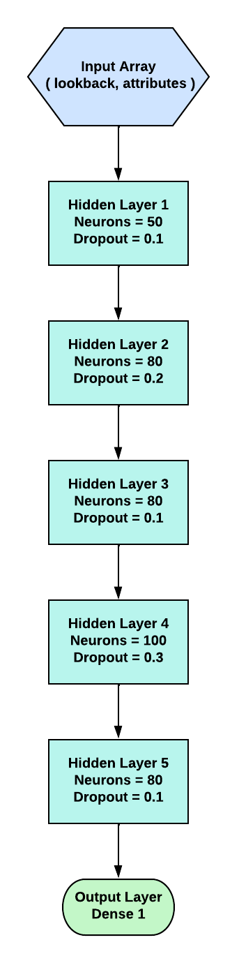
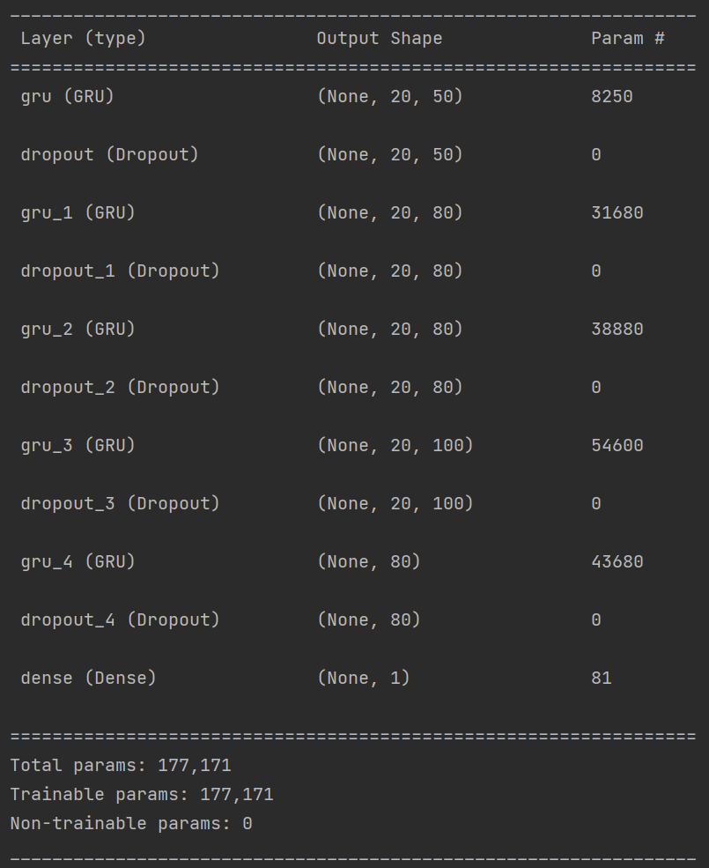
GRU Architecture Subsystem
Kevin H. Sipple - Final Implemented Network
Graphically

Slide 13
GRU Architecture Subsystem
Kevin H. Sipple - Major Challenges and Solutions
Challenges
Mitigations to prevent overtraining the model
GRU required a flexible input shape (attributes, lookback)
Running scripts from GUI between GRU/Data Scraper
High variability in available data
(request timeouts, NaNs, Listing date)
Solutions
Implemented dropout points in the layers as well as tinkered with amount of neurons and epochs
Created the GRU as a function with parameters that will be cleared from the Keras backend
Used Python threading library to interface between the GUI→Scraper; terminated GUI for GUI→GRU
Error catches for missing attributes that allow for continuation without them

Slide 14
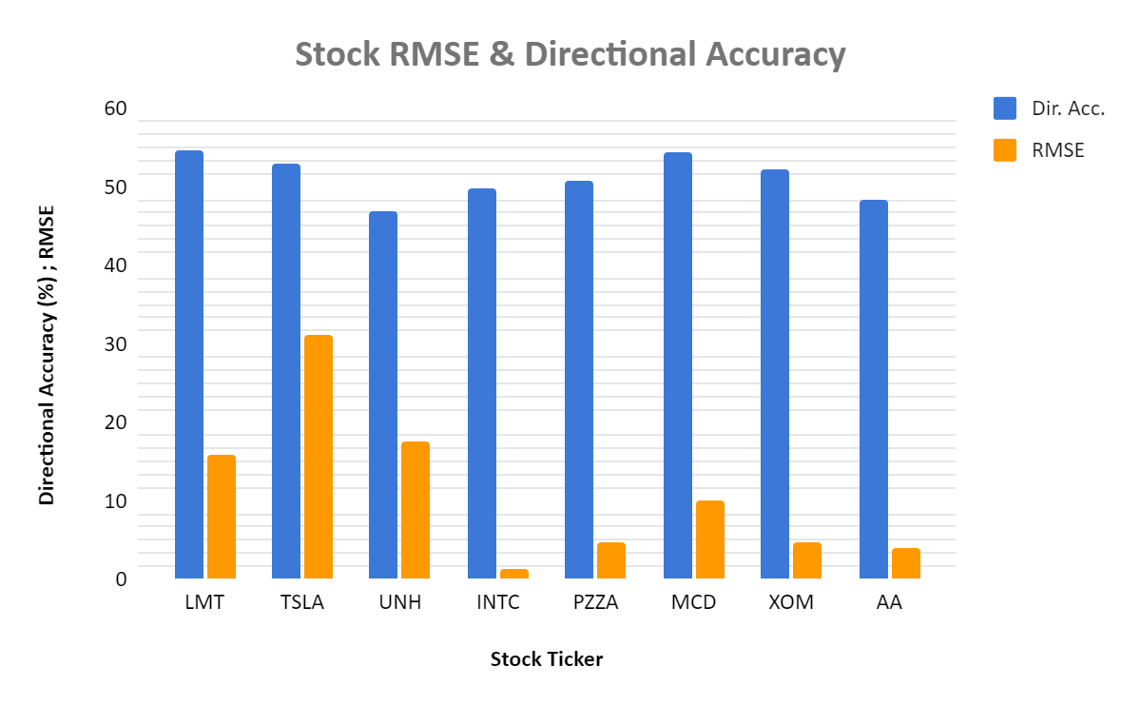
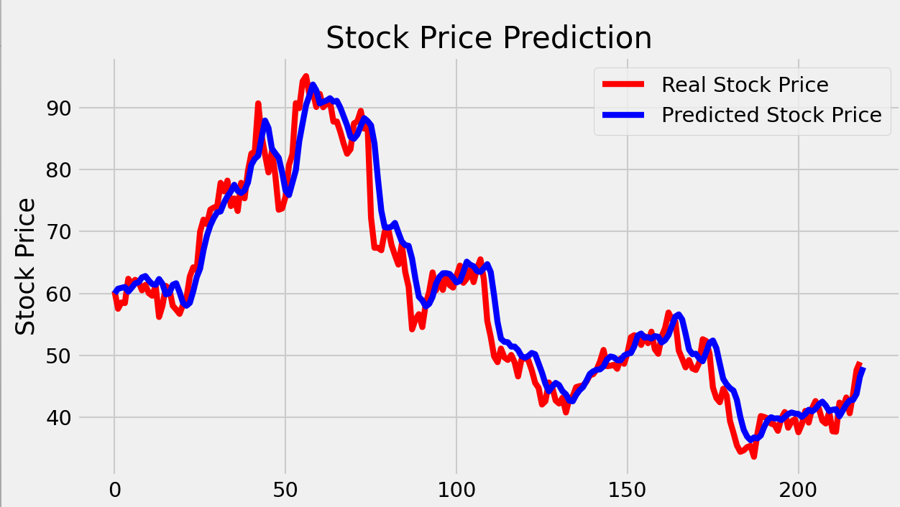
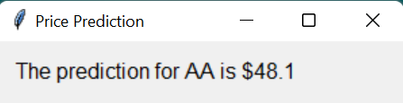
GRU Architecture Subsystem
Kevin H. Sipple - Results
Network Validation of
Alcoa Corp (AA)
Notes:
SEAN

Slide 15
FPGA Subsystem Sean Kwatra
Notes:
Xavier

Slide 16
FPGA Subsystem
Sean Kwatra - Overview
The procured FPGA is a ZCU-104 manufactured by Xilinx
Embedded with Debian Linux and can connect to the internet
The FPGA contains all of the Python scripts/libraries necessary to run the two other subsystems
Connection can be made using an SSH terminal on campus to run the scripts remotely
Image of the ZCU-104:
Notes:
SEAN

Slide 17
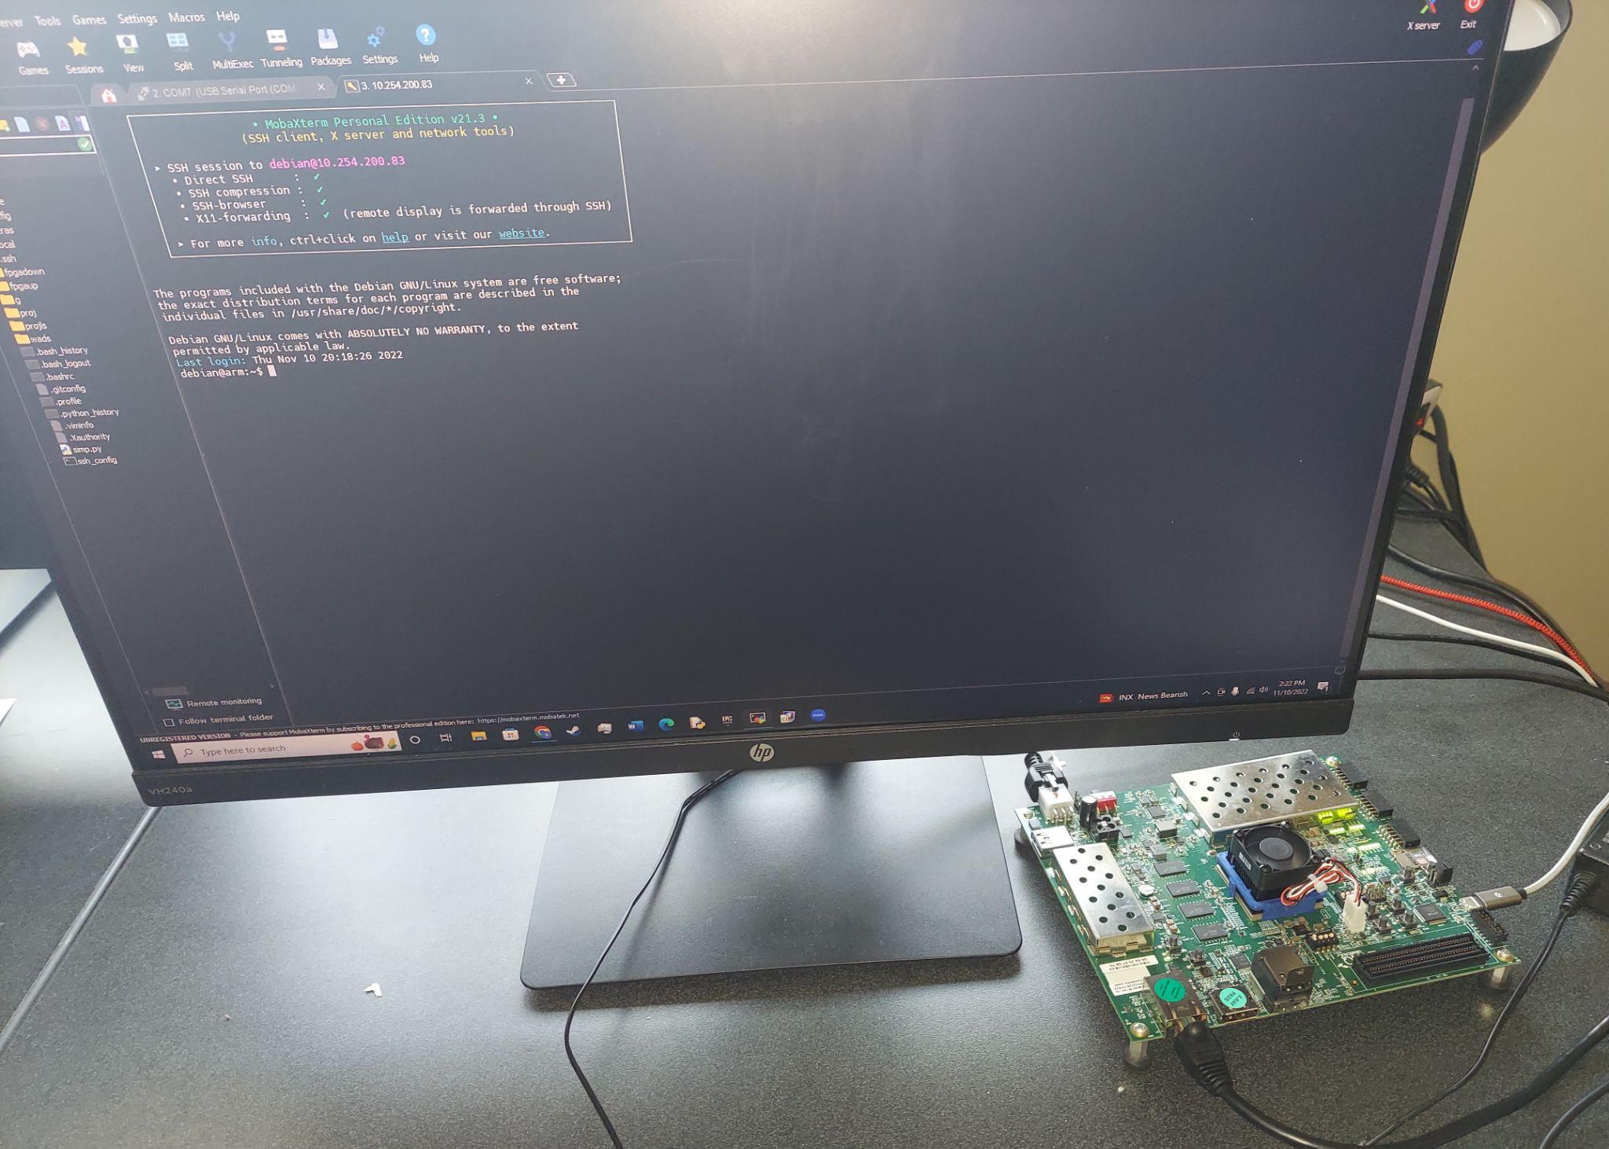
FPGA Subsystem
Sean Kwatra - FPGA Connected to SSH

Slide 18
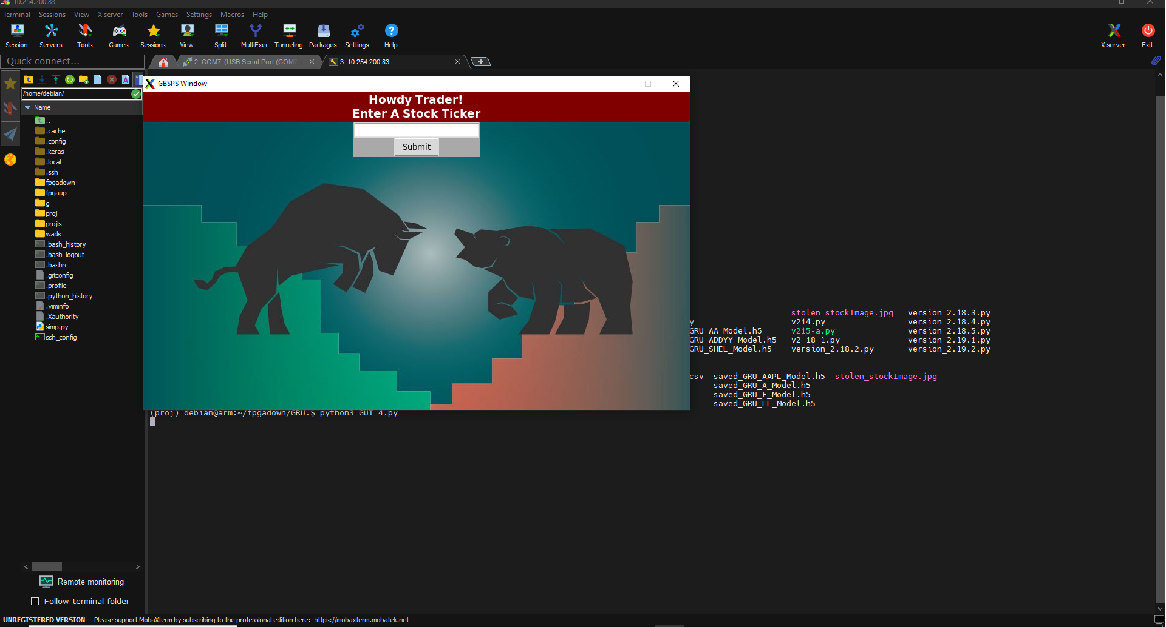
FPGA Subsystem
Sean Kwatra - SSH terminal Connection to GUI on FPGA

Slide 19
FPGA Subsystem
Sean Kwatra - Challenges & Solutions
Challenge | Solution
Running Python scripts on an FPGA | Embed a custom version of Debian Linux onto the FPGA
Running a Tensorflow v2.10 GRU script onboard an FPGA | Upgrade to a 64-bit systems since all GRU require it
No graphical display on the FPGA to output to | Install and customize an SSH terminal to allow for remote access and X11 forwarding

Slide 20
FPGA Subsystem
Sean Kwatra - Full Subsystem Status
Task | Explanation | Result
Procure FPGA | ZCU-104 | Complete
Design and Mount Case | Create Case to protect the ZCU-104 from outside harm | Removed by sponsor
Embed Linux | Use PetaLinux to install a custom embedded linux system | Complete
Ensure compatibility of a Tensorflow based GRU on the FPGA | Install and use a version of tensorflow that runs on AArch64 | Complete
Integrate the full GRU on the FPGA | Using the new Tensorflow run the full GRU to analyze a stock of choice | Complete
Integrate the Data Scraper on the FPGA | Connect the FPGA to the internet and collect all necessary data on a particular stock | Complete
Run the integrated GRU and Data Scraper on the FPGA | Run both scripts to both collect data and analyze it | Complete

Slide 21
System
Conclusion
Notes:
Xavier

Slide 22
Integrated System Compatibility Results
Ticker
LMT | AA
TSLA | GE
UNH | DAL
INTC | META
PZZA | SHEL
MCD | WEN
XOM | TXN
LUV | F
NVDA | AAPL
TXN | SBUX
Folks in the design lab were asked what stocks they were interested in
8 Random attribute combinations were selected
Trained models with 5 epochs
All data and models were generated successfully by the subsystems
~40 mins for each model
Scaled we use a max of 32 combos and increase epochs to 15 to stay within our 8hr constraint

Slide 23
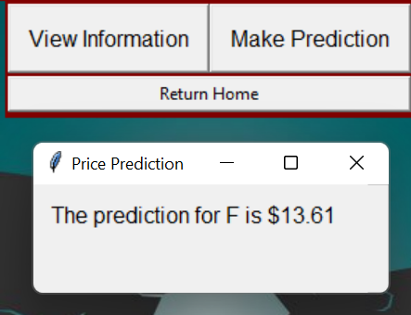
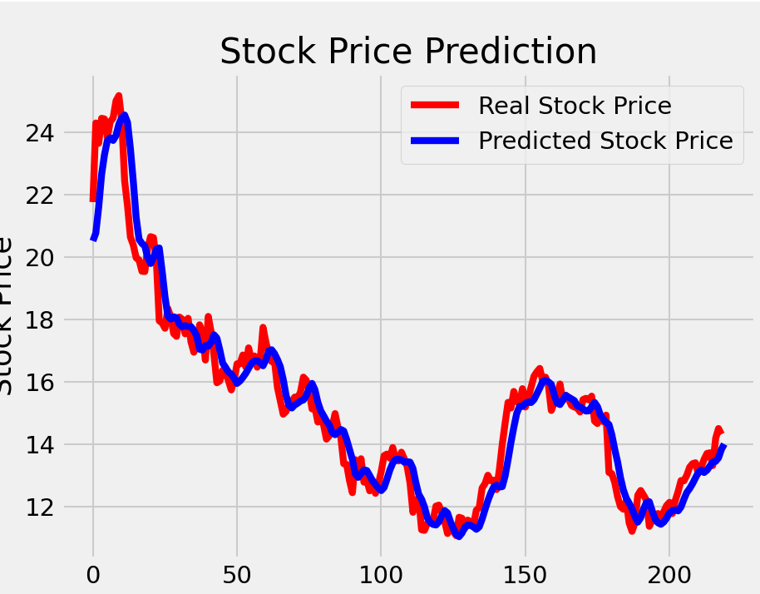
Analysis Of System Operating On Ford Stock
Ford Motor Company (F)
Attribute Combination | RMSE | Directional Accuracy (%)
High, Low, Open | 1.138 | 53.21
High, Low | 1.474 | 53.67
High, Low, EPS, Day | 1.389 | 56.42
Graph of Ford Model showing
Predicted Close Price against the Real Close Price
With a score of 1.138 RMSE

Slide 24
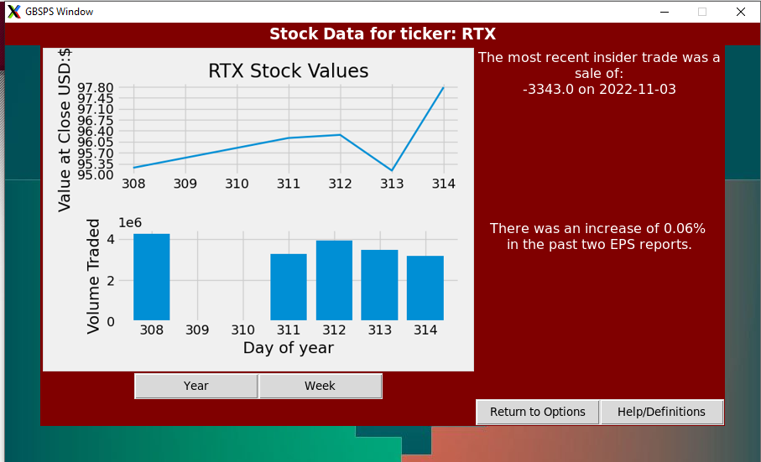
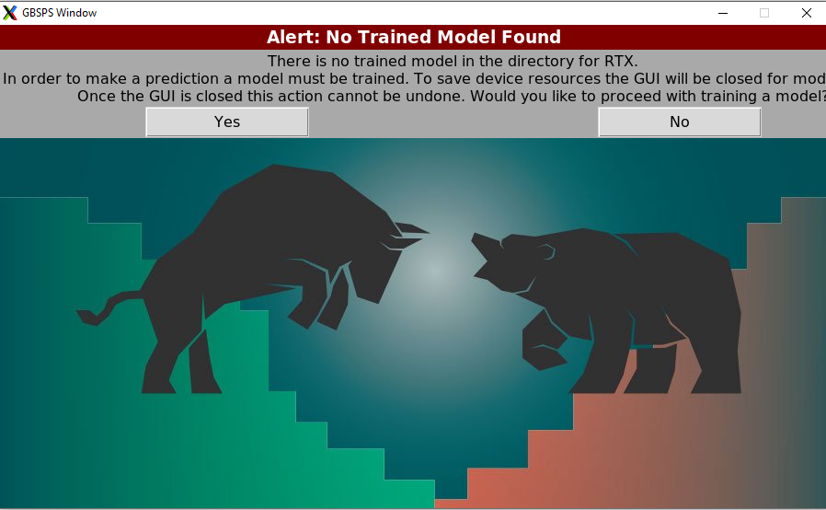
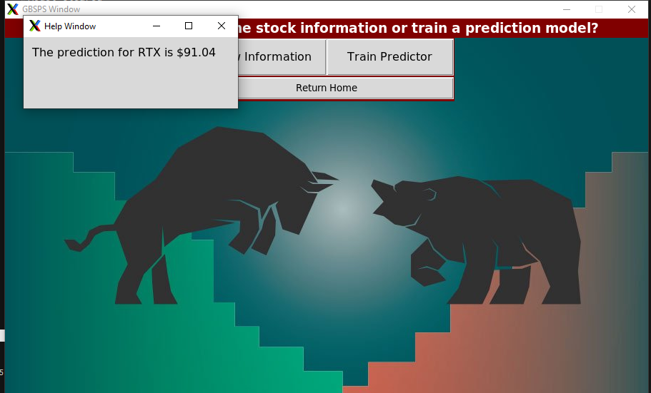
Full GBSPS Operating

Slide 25
Conclusion
Changes to the FSR:
Switched FPGA to the ZCU-104
The previous FPGA could not support a GRU
Increase of system cost
Directional Accuracy was superseded by RMSE per the sponsor’s request
The need for a case to house the FPGA was eliminated
Our sponsor deemed it unnecessary for the project
The need to install a fan and heatsink on the FPGA was removed
ZCU-104 came with onboard fan and thermal shut off
Current Status:
System has met all sponsor desired specifications!
All subsystems are fully integrated onboard the FPGA!
The GUI is functional as well and allows for better user interaction
Until demo we are working with the machine learning optimization team

Slide 26
Thank you!
Notes:
Xavier

